Slide 1
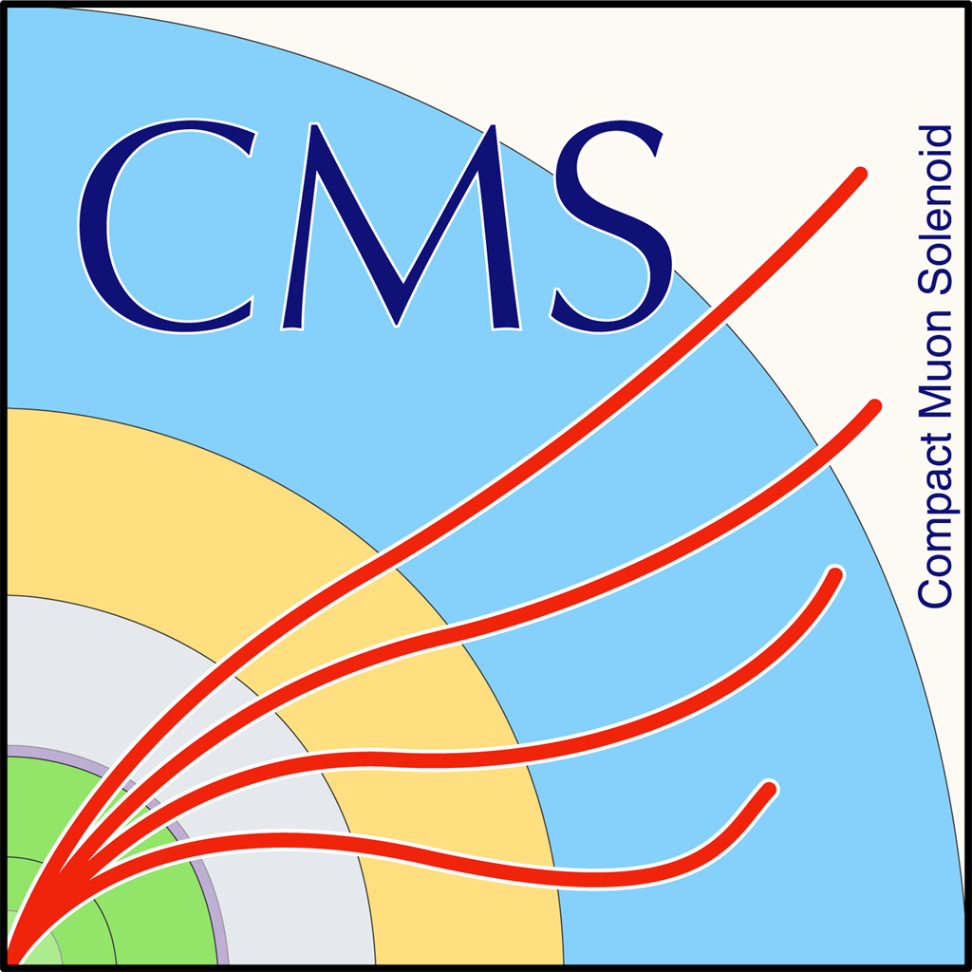

TTbar Differential Cross Section in Fully Hadronic Status Update
K. Kousouris, Y. Tsipolitis, I. Papakrivopoulos, G. Bakas
For NTUA

Slide 2
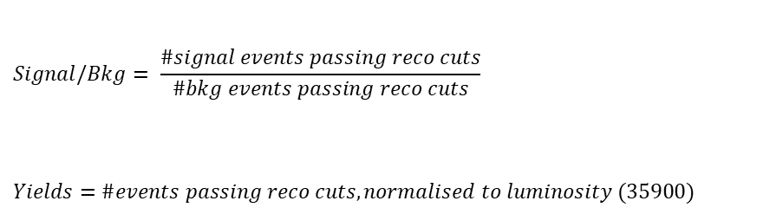
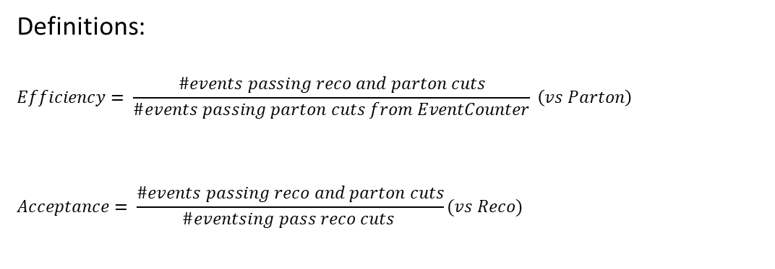
Overview
Efficiencies and Acceptance for mTT and jetPt variables
Selection:
Jet Matching
Parton cuts:
partonPt[0],[1] > 400
|partonEta[0],[1]| < 2.4
mTTbarParton > 1000
Reco cuts:
nJets > 1
nLeptons = 0
mJJ > 1000
jetPt[0],[1] > 400
|jetEta[0],[1]| < 2.4
bTagging (Medium WP deepCSV)
Tagger cut (top Tagger)
JetMassSoftDrop > 120 and < 220
Definitions:
$$Efficiency= \frac{\#events passing reco and parton cuts}{\#events passing parton cuts from EventCounter} \left(vs Parton\right)$$
$$Acceptance= \frac{\#events passing reco and parton cuts}{\#eventsing pass reco cuts }(vs Reco)$$
$$Signal/Bkg= \frac{\#signal events passing reco cuts}{\#bkg events passing reco cuts}$$
$$Yields=\#events passing reco cuts, normalised to luminosity (35900)$$

Slide 3
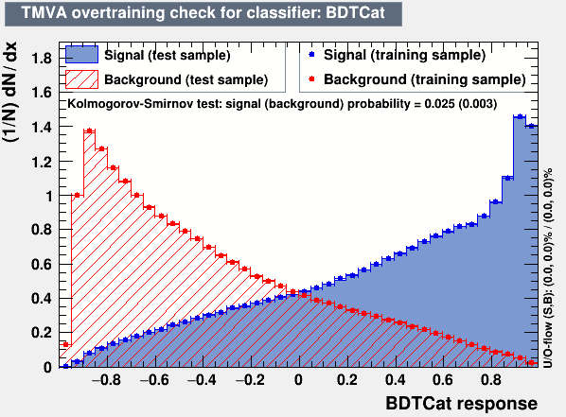
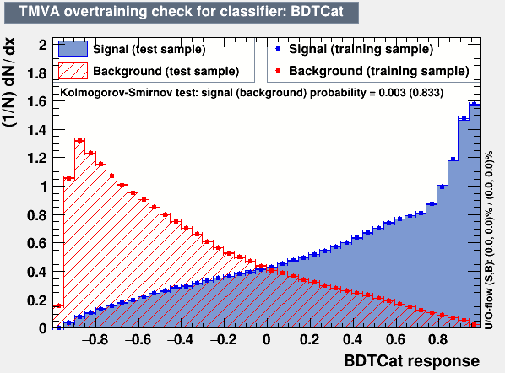
Training Outputs
2017
2018

Slide 4
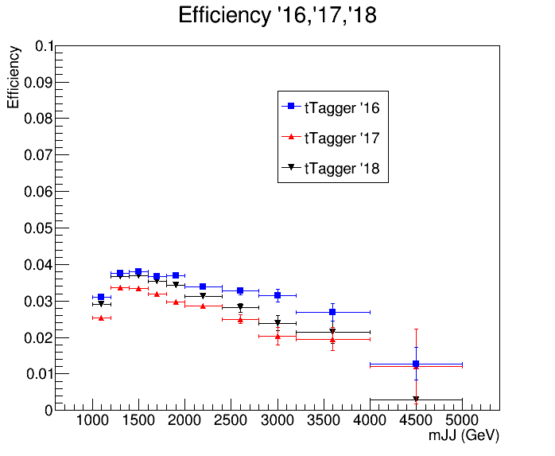
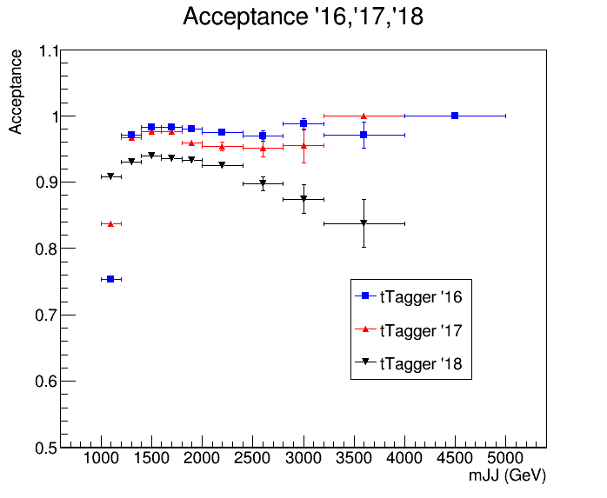
Acceptance and Efficiency 2016 vs 2017 vs 2018

Slide 5
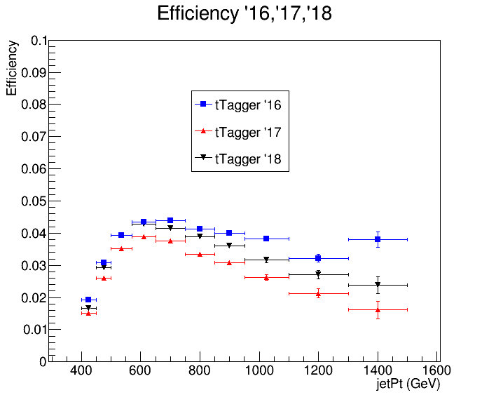
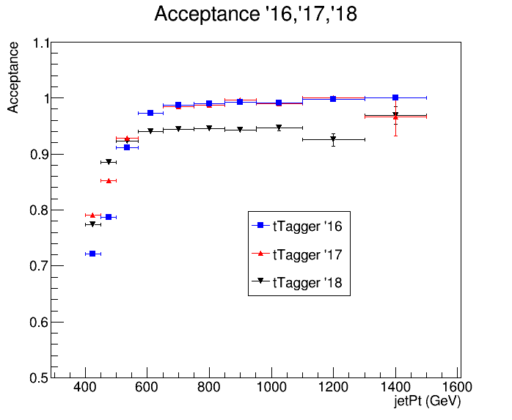
Acceptance and Efficiency 2016 vs 2017 vs 2018

Slide 6
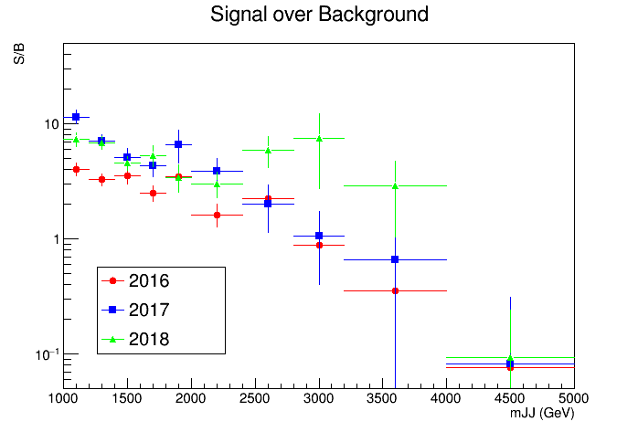
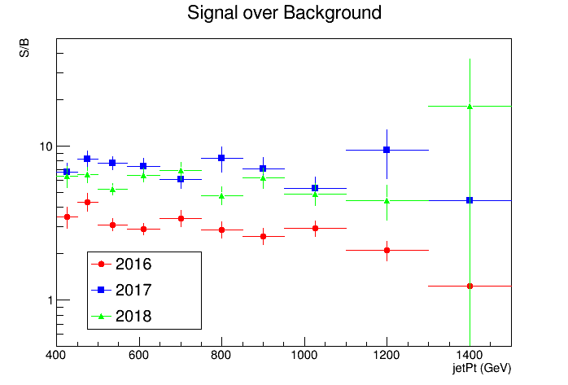
Signal over Background 2016 vs 2017 vs 2018

Slide 7
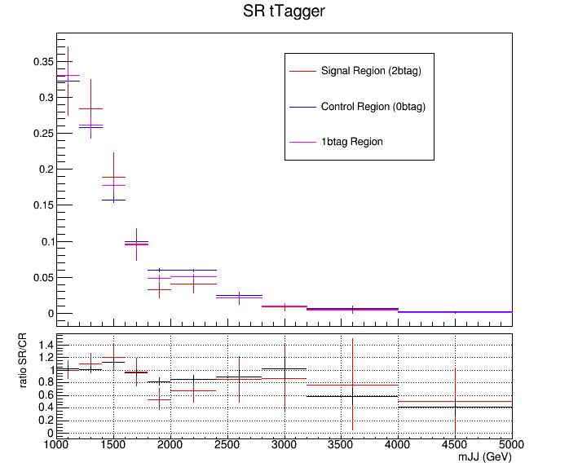
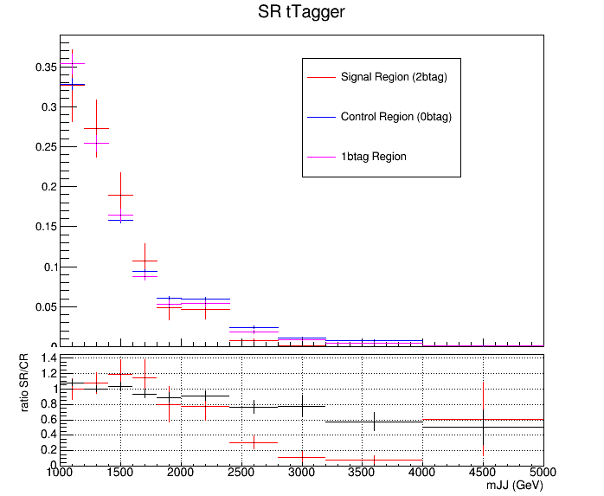
QCD Closure Tests 2017 vs 2018
2017
2018

Slide 8
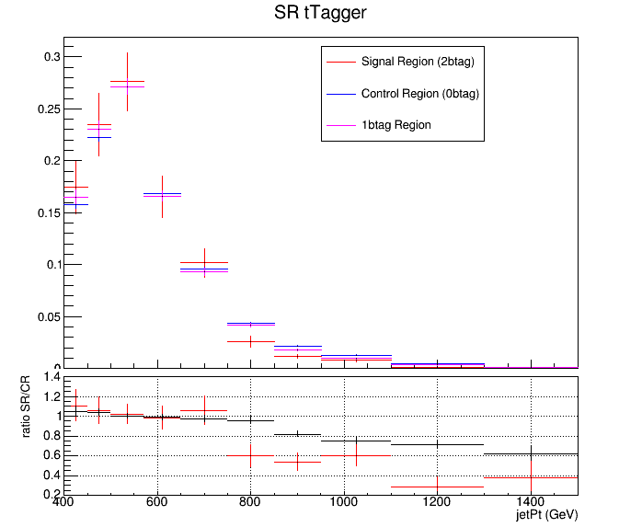
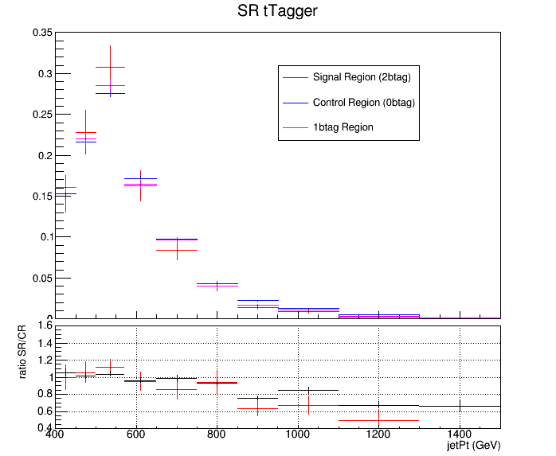
QCD Closure Tests 2017 vs 2018
2017
2018

Slide 9
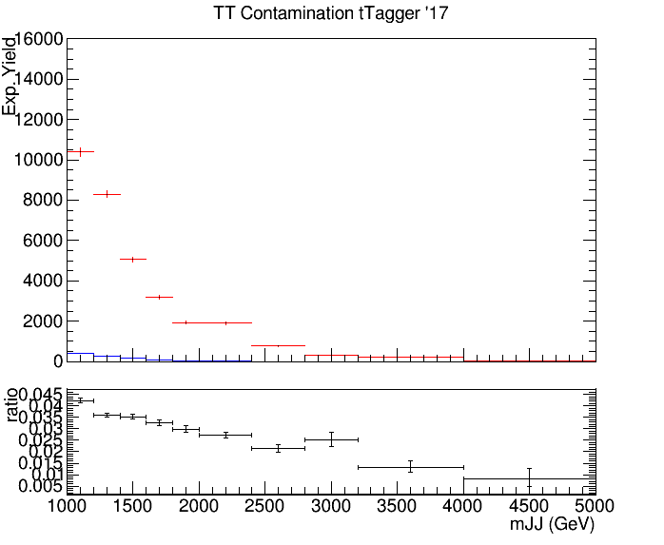
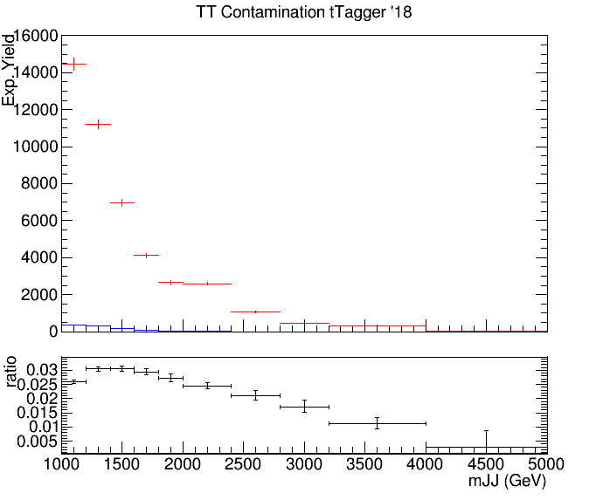
TT Contamination 2017 vs 2018
2017
2018
Control Region QCD sample
Control Region QCD sample
Control Region TT sample
Control Region TT sample

Slide 10
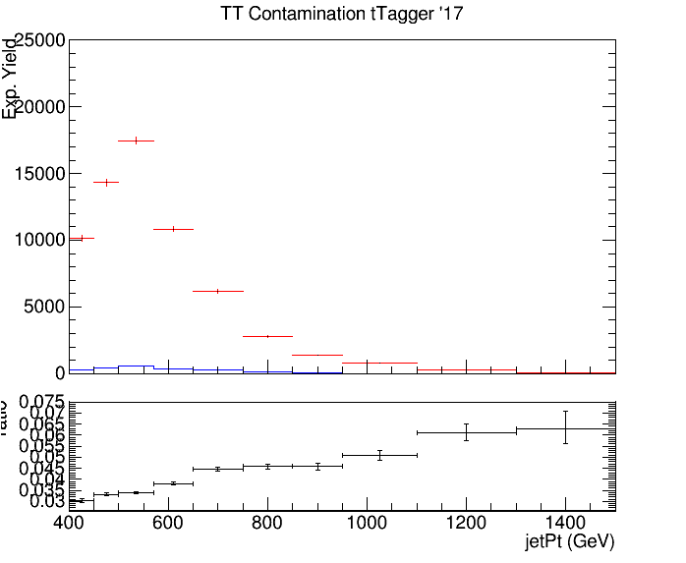
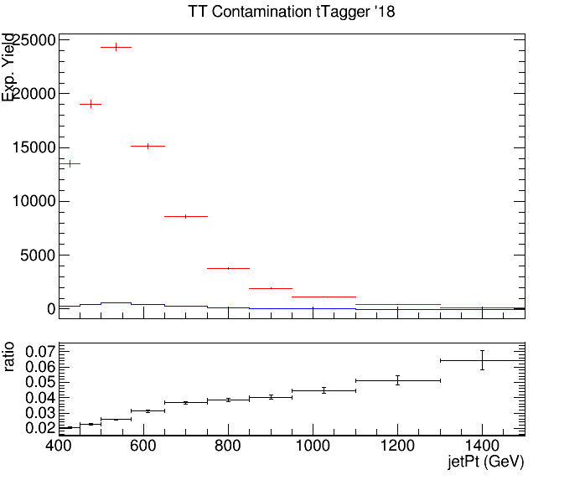
TT Contamination 2017 vs 2018
2017
2018
Control Region QCD sample
Control Region QCD sample
Control Region TT sample
Control Region TT sample

Slide 11
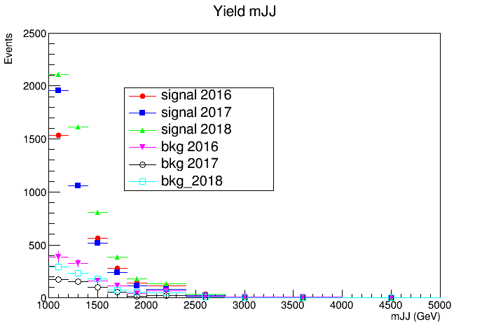
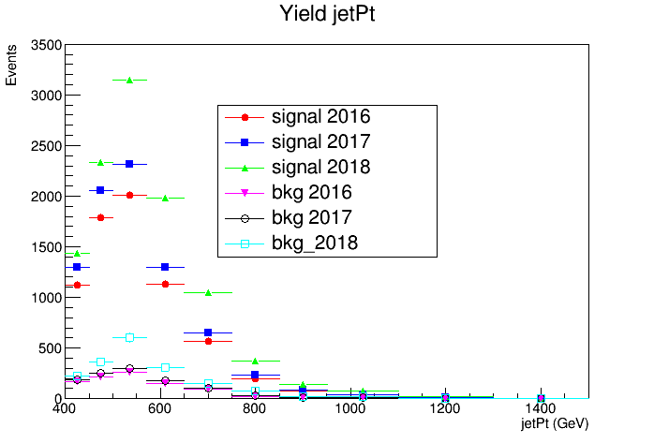
Yields 2016 vs 2017 vs 2018

Slide 12
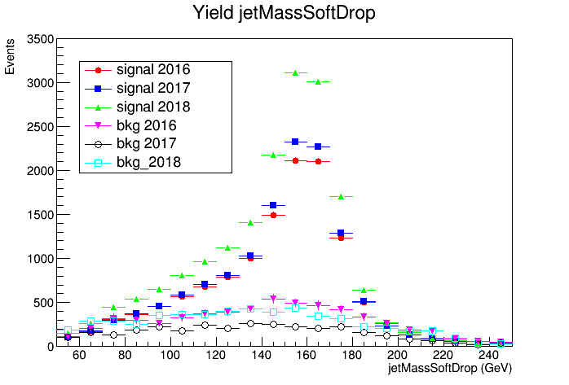
Yields 2016 vs 2017 vs 2018

Slide 13
Comments
The 2018 efficiencies and acceptances vary compared with 2016 and 2017. I think that we should rethink the working point of the top Tagger for this year.
The QCD 2018 closure test does not show closure for both variables compared with the 2017 QCD closure tests (Maybe different CMSSW for 2018? )
The tt contamination seems to be lower for the 2018 compared with the 2017 MC

Slide 14
BACKUP

Slide 15
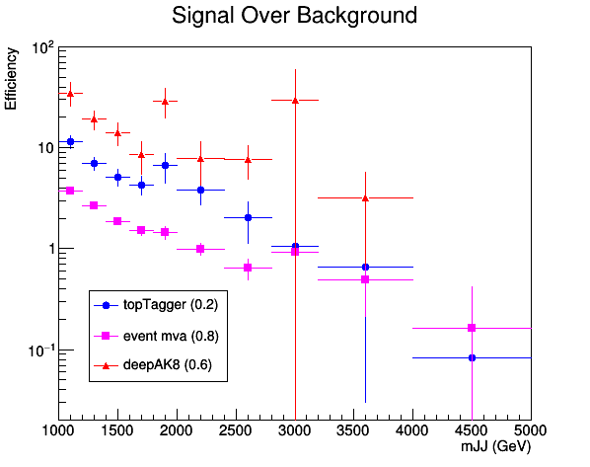
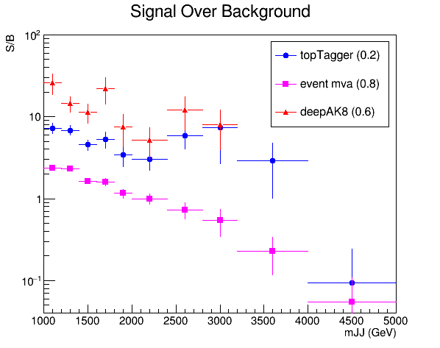
Signal over Background deepCSV 2017 vs 2018
2017
2018

Slide 16
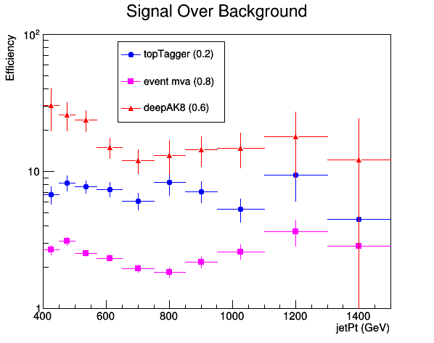
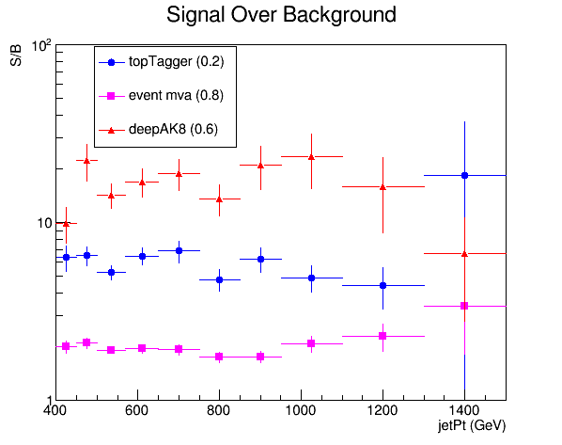
Signal over Background deepCSV 2017 vs 2018
2017
2018

